Slide 1


Performance and Power of Cache-Based Reconfigurable Computing
Andrew Putnam, Susan Eggers
Dave Bennett, Eric Dellinger, Jeff Mason,
Henry Styles, Prasanna Sundararajan, Ralph Wittig
University of Washington -- CSE
Xilinx Research Labs

Slide 2

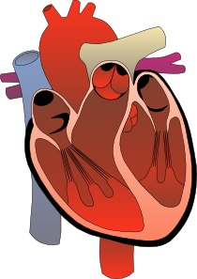
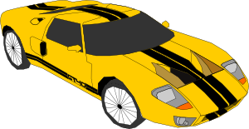

High-Performance Computing
Results have a real impact on your life
Lots of parallelism, large data sets
Still starved for compute power
$12 billion market in 2008
Domain | Applications
Scientific | Climate modeling, molecular dynamics, earthquake prediction
Medical | Pharmaceuticals, CT scanners, medical imaging
Commercial | Oil and gas exploration, automotive safety models
Defense & Security | Radar & Air traffic control, satellite image processing, data security
Financial | Options pricing, risk assessment

Slide 3
Changing Technology Landscape
More processors, not faster processors
Many programmers never write explicitly parallel code
Programmers who parallelize struggle to scale
Power is as important as performance
Cost of power drives data center construction, operation
Are there high-performance, power-efficient, low-cost alternatives to simply adding more processors?

Slide 4
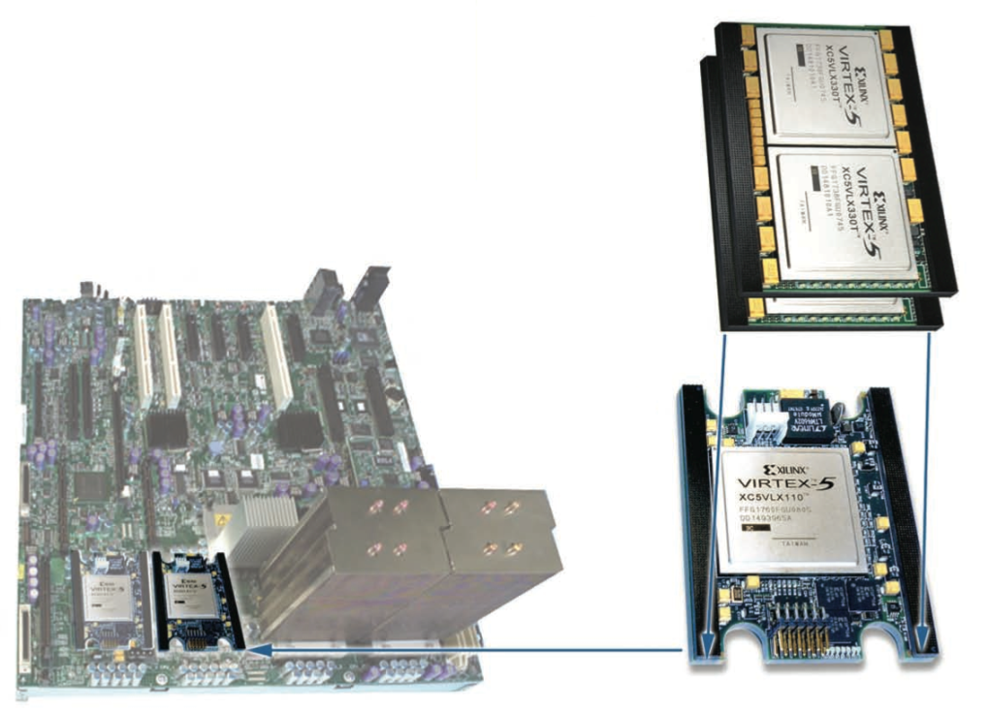
FPGA-based Computing
Sea of generic logic, memory, and interconnect
Configure into lots of custom processing elements for parallelism
Low power due to efficiency (5-15 W)
You have to write your application in a Hardware Description Language (HDL)

Slide 5
HPC Developers
HPC / Scientific User Base
Expertise is in their application domain
C / Fortran programmers
Familiar with caches
Not used to dealing with hardware design concepts
HPC Wish List
Re-use existing code
Program and run in the normal C environment
Compiler/hardware handle parallelism
Portable, scales to future hardware

Slide 6
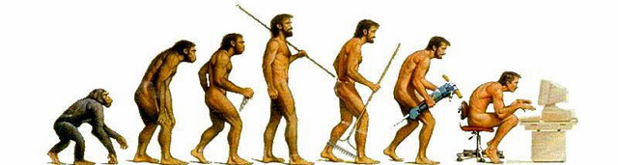
CHiMPS’ Goals
C compiler for FPGAs
Work with largely unmodified source code
Automatically, efficiently support the C memory model
Run on existing hardware and operating systems
Better performance than CPU-only execution
Lower Power
Emphasis on ease-of-use over maximum performance

Slide 7
Outline
CHiMPS and the Many-Cache Architecture
Related Work
Many-Cache Model
Cache Generation & Optimization
Target Platform
Results
Performance
Power
Conclusions

Slide 8
Related Work – C for FPGAs
Datapath:
Spatial Dataflow
Memory:
HDLs with C syntax
Catapult-C, Handel-C
Functional Languages
Mitrion-C, SA-C, ROCCC
Streaming
Streams-C, NAPA-C, Impulse-C
HDL
Streaming
Performance
Functional Languages
CHiMPS
Development Effort

Slide 9
Related Work - Caches
Conventional CPU cache
CASH, Tartan
Concluded that memory system is the bottleneck
Latency-optimized cache, throughput-optimized datapath
PE
PE
PE
PE
PE
PE
PE
PE
PE
PE
PE
PE
PE
PE
PE
PE
Cache
PE
PE
PE
PE
PE
PE
PE
PE
PE
PE
PE
PE
PE
PE
PE
PE
PE
PE
PE
PE
PE
PE
PE
PE

Slide 10
Many-Cache
Distribute caches throughout parallel datapath
Customize each cache for how it is used
Capacity, line size
Reads/writes per cycle
Keep memory and computation together
PE
PE
PE
Cache
PE
PE
Cache
PE
PE
PE
PE
PE
PE
PE
PE
PE
PE
PE
PE
PE
PE
PE
Cache
PE
PE
PE
PE
PE
PE
PE
PE
Cache
PE
PE
PE
PE
PE
PE
PE
PE
PE
PE
Cache

Slide 11
Caching Example
void matmul(long* a, long* b, long* c, long sz)
{
long i, j, k;
for (i = 0; i < sz; i++)
{
long offset = i * sz;
long* row = a + offset;
long* out = c + offset;
for (j = 0; j < sz; j++)
{
long* col = b + j;
out[j] = 0;
for (k = 0; k < sz; k++) {
out[j] += row[k] * col[k*sz];
}
}
}
}
out[j]
out[j]
row[k]
row[k]
col[k*sz]
col[k*sz]
Cache
read
read
read
read
read
read
mul
mul
add
add
write
write
for( k=0; k < sz; k++ ) {
out[j] += row[k] * col[k*sz];
}

Slide 12
Problems with a Single Cache
Long Wires
out[j]
row[k]
col[k*sz]
Cache
read
read
read
mul
add
write

Slide 13
Problems with a Single Cache
Long Wires
Arbitration latency
read
read
Cache
read
Cache
Cache
read
write
read
read
read
write
read
read
read
write
read

Slide 14
Problems with a Single Cache
Long Wires
Arbitration latency
Sharing conflicts
out[j]
row[k]
col[k*sz]
out[]
Cache
read
read
read
row[]
mul
col[]
add
write

Slide 15
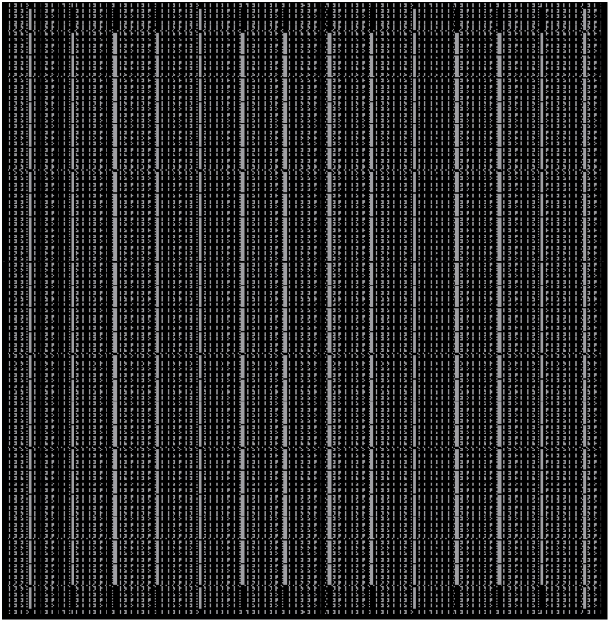
Problems with a Single Cache
Long Wires
Arbitration latency
Sharing conflicts
Bad match for distributed FPGA memories
Generic Logic
RAM
RAM
RAM
RAM
4kB Block RAMs
FPGA

Slide 16
CHiMPS Many-Cache Architecture
out[j]
row[k]
col[k*sz]
read
read
read
mul
add
write
for( k=0; k < sz; k++ ) {
out[j] += row[k] * col[k*sz];
}

Slide 17
CHiMPS Many-Cache Architecture
out[j]
row[k]
col[k*sz]
Cache
read
read
read
mul
add
write
for( k=0; k < sz; k++ ) {
out[j] += row[k] * col[k*sz];
}

Slide 18
CHiMPS Many-Cache Architecture
Cache
Cache
out[j]
row[k]
col[k*sz]
read
read
read
Cache
mul
add
write
for( k=0; k < sz; k++ ) {
out[j] += row[k] * col[k*sz];
}

Slide 19
CHiMPS Many-Cache Architecture
row[]
col[]
out[j]
row[k]
col[k*sz]
read
read
read
out[]
mul
add
write
for( k=0; k < sz; k++ ) {
out[j] += row[k] * col[k*sz];
}

Slide 20
CHiMPS Many-Cache Architecture
row[]
Read-Only
col[]
Read-Only
out[j]
row[k]
col[k*sz]
read
read
read
out[]
R/W
mul
add
write
for( k=0; k < sz; k++ ) {
out[j] += row[k] * col[k*sz];
}

Slide 21
CHiMPS Many-Cache Architecture
col[]
Read-Only
row[]
Read-Only
out[j]
row[k]
col[k*sz]
out[]
R/W
read
read
read
mul
add
write
for( k=0; k < sz; k++ ) {
out[j] += row[k] * col[k*sz];
}

Slide 22
CHiMPS Many-Cache Architecture
Bank 1
Bank 1
out[j]
row[k]
col[k*sz]
Bank 2
Bank 2
Bank 1
read
read
read
Bank 2
mul
Bank 3
add
Bank 4
write
for( k=0; k < sz; k++ ) {
out[j] += row[k] * col[k*sz];
}

Slide 23
Many-Cache Benefits
Shorter wires
Lower latency
Fewer sharing conflicts
Better match for distributed FPGA memories
Customize each cache
Bank 1
Bank 1
out[j]
row[k]
Bank 2
col[k*sz]
Bank 2
read
read
read
Bank 1
Bank 2
mul
Bank 3
Bank 4
add
write

Slide 24
Outline
CHiMPS and the Many-Cache Architecture
Related Work
Many-Cache Model
Cache Generation & Optimization
Target Platform
Results
Performance
Power
Conclusions

Slide 25
Compilation Flow
C Code
Extract Dataflow Graph
CHiMPS Compiler
(Front End)
Optimization
Looks like a standard C compiler
Standard FPGA toolflow from VHDL to bitstream
2-step flow makes CTL portable
Alias Analysis
Cache Specification
CHiMPS Compilation Engine
CHiMPS Target Language (CTL)
CHiMPS Hardware
Generator
(Back End)
Datapath Optimization
Resource Estimation
Cache Creation
VHDL
Post HW Gen Optimization
Place & Route
Standard FPGA Toolflow
FPGA Bitstream

Slide 26
Analyses for Cache Creation
Identify independent regions of memory
Alias analysis, restrict keyword
Categorize memory regions by access type
Order memory operations within each region
Apply loop interchange (if necessary)
C Code
Extract Dataflow Graph
CHiMPS Compiler
(Front End)
Optimization
Alias Analysis
Cache Specification
CHiMPS Target Language (CTL)

Slide 27
Cache Generation
Resource estimation
Cache Body Configuration
Cache size based on available block RAM resources
Banks based on number of simultaneous reads/writes
CHiMPS Target Language (CTL)
Datapath Optimization
CHiMPS Hardware
Generator
(Back End)
Resource Estimation
Cache Creation
Post HW Gen Optimization
VHDL

Slide 28
Post-Generation Optimization
Loop Unrolling
Replicates instruction blocks within a loop
Replicates caches (if possible)
Tiling
Duplicates entire function
Operates on independent data sets
CHiMPS Target Language (CTL)
Datapath Optimization
CHiMPS Hardware
Generator
(Back End)
Resource Estimation
Cache Creation
Post HW Gen Optimization
VHDL

Slide 29
Coherence in Many-Cache
Coherence protocol is too heavy-weight for many small caches
Only one cache can hold a writable memory location at a time
Flush data from cache to cache between program phases
PE
PE
PE
Phase 1
PE
PE
PE
FPGA
Phase 2a
Load
PE
Load
Phase 2b
Main Memory
CPU

Slide 30
Coherence in Many-Cache
Coherence protocol is too heavy-weight for many small caches
Only one cache can hold a writable memory location at a time
Flush data from cache to cache between program phases
PE
PE
PE
Phase 1
PE
PE
PE
FPGA
Flush
Flush
Phase 2a
Load
PE
Phase 2b
Main Memory
CPU

Slide 31
Coherence in Many-Cache
Coherence protocol is too heavy-weight for many small caches
Only one cache can hold a writable memory location at a time
Flush data from cache to cache between program phases
PE
PE
PE
Phase 1
PE
PE
PE
FPGA
Phase 2a
PE
Phase 2b
Flush
Main Memory
CPU

Slide 32
Coherence in Many-Cache
Coherence protocol is too heavy-weight for many small caches
Only one cache can hold a writable memory location at a time
Flush data from cache to cache between program phases
PE
PE
PE
Phase 1
PE
PE
PE
FPGA
Phase 2a
PE
Phase 2b
Main Memory
Load
CPU

Slide 33
Coherence in Many-Cache
Coherence protocol is too heavy-weight for many small caches
Only one cache can hold a writable memory location at a time
Flush data from cache to cache between program phases
PE
PE
PE
Phase 1
PE
PE
PE
FPGA
Phase 2a
PE
Phase 2b
Main Memory
CPU

Slide 34
Outline
CHiMPS and the Many-Cache Architecture
Related Work
Many-Cache Model
Cache Generation & Optimization
Target Platform
Results
Performance
Power
Conclusions

Slide 35
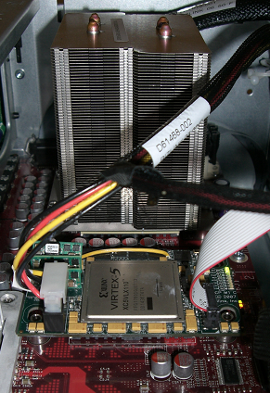
Target Platform – Xilinx ACP
Multi-socket motherboard
Intel 2.66 GHz 4-core Xeon
Xilinx Virtex-5 LX110T
CPU and FPGA are peers
Share the system bus (FSB)
8.6 GB/s read bandwidth
5.0 GB/s write bandwidth
108 ns memory latency
CPU
CPU Heatsink
FPGA

Slide 36
Outline
CHiMPS and the Many-Cache Architecture
Related Work
Many-Cache Model
Cache Generation & Optimization
Target Platform
Results
Performance
Power
Conclusions

Slide 37
Methodology
Firmware for ACP is still under development
Hybrid evaluation methodology
Component power, performance from microbenchmarks on ACP
Used as input to cycle-accurate simulator
Area, frequency based on synthesis to ACP’s FPGA
Benchmark results validated with full VHDL implementation of kernels on prior platform
Benchmarks are generic, unmodified C except:
pragma selects code for FPGA
restrict keyword: specifies that pointers passed as function parameters are independent

Slide 38
CPU-Like Cache
Only 1.08x average performance boost over a CPU

Slide 39
Multiple Banks
2.2x for single, 2 bank cache
3.0x for single, 4 bank cache

Slide 40
Many-Cache
3.0x for single, multi-bank cache
3.6x for many, multi-bank cache

Slide 41
Many-Cache
4.5x for optimized, single, multi-bank cache
7.8x for optimized, many, multi-bank caches
64

Slide 42
Black-Scholes
baseline
128k
D

Slide 43
Black-Scholes
baseline
128k
D
128k
D
unroll x2
128k
D

Slide 44
Black-Scholes
baseline
128k
D
128k
D
unroll x2
128k
D
D
64k
64k
D
unroll x4
D
64k
64k
D

Slide 45
Black-Scholes
baseline
128k
D
128k
D
unroll x2
128k
D
D
64k
64k
D
unroll x4
D
64k
64k
D
D
32k
32k
D
D
32k
32k
D
unroll x8
D
32k
32k
D
D
32k
32k
D

Slide 46
Smith-Waterman
query
db
128k
Read-Only
128k
Read-Only
D
score
128k

Slide 47
Smith-Waterman
query
db
64k
64k
D
score
128k
D
64k
64k
query
db

Slide 48
Smith-Waterman
query
db
64k
64k
D
D
score
128k
D
D
64k
64k
query
db

Slide 49
Smith-Waterman
query
db
32k
32k
D
D
D
D
score
32k
db
32k
128k
db
query
32k
32k
query
D
D
D
D
32k
32k
query
db

Slide 50
Outline
CHiMPS and the Many-Cache Architecture
Related Work
Many-Cache Model
Cache Generation & Optimization
Target Platform
Results
Performance
Power
Conclusions

Slide 51
Power vs. CPU
Power measured vs. 1-CPU system for same source code
4.1x lower than CPU (geometric mean)
*
*
*
*
*

Slide 52
Performance per watt
21.3x advantage over CPU
*
*
*
*
*

Slide 53
Outline
CHiMPS and the Many-Cache Architecture
Related Work
Many-Cache Model
Cache Generation & Optimization
Target Platform
Results
Performance
Power
Conclusions

Slide 54
Conclusions
Many-cache enables HPC developers to automatically and easily accelerate their applications using FPGAs
Making caches work on FPGAs requires:
Multiple banks
Multiple caches
Customizing caches to the application
Standard compiler optimizations
The result is:
Seamless use of FPGAs by HPC developers
7x the performance of a CPU
4x lower power consumption

Slide 55
Thank You
http://www.cs.washington.edu/homes/aputnam
aputnam@cs.washington.edu

Slide 56
ACP Cache Parameters
392kB total data cache
Significant frequency drop after 128k
Banking has little impact on frequency

Slide 57
Caches, Area, and Frequency
 | Caches | Area (Slices) | Multipliers
Black-Scholes
baseline unroll x2 unroll x4 unroll x8 | 1 2 4 8 | 5605 (32%) 7436 (43%) 11585 (67%) 16427 (95%) | 9 (14%) 18 (28%) 36 (56%) 63 (97%)
Smith-Waterman
baseline unroll x2 unroll x4 unroll x8 | 3 5 5 9 | 5574 (32%) 6779 (39%) 9735 (56%) 15569 (90%) | 0 (0%) 0 (0%) 0 (0%) 0 (0%)
dgemm
baseline tile x2 | 3 6 | 5832 (34%) 9447 (55%) | 43 (67%) 63 (97%)
immul
baseline tile x2 tile x4 | 3 6 6 | 4634 (27%) 7164 (41%) 12140 (70%) | 12 (19%) 24 (38%) 48 (75%)
idct
baseline tile x2 | 1 2 | 10553 (61%) 16335 (95%) | 63 (97%) 63 (97%)

Slide 58
Spatial Dataflow
y
x
5
int foo (int x, int y)
{
int sum = x + y;
int z;
if( x > 5 )
z = sum + x;
else
z = sum – y;
return z;
}
add
cmp
sum
x>5
add
sub
z
z
if
z

Slide 59
Spatial Dataflow
y
x
5
int foo (int x, int y)
{
int sum = x + y;
int z;
if( x > 5 )
z = sum + x;
else
z = sum – y;
return z;
}
add
cmp
sum
x>5
add
sub
z
z
if
z

Slide 60
Spatial Dataflow
y
x
5
int foo (int x, int y)
{
int sum = x + y;
int z;
if( x > 5 )
z = sum + x;
else
z = sum – y;
return z;
}
add
cmp
sum
x>5
add
sub
z
z
if
z

Slide 61
Spatial Dataflow
y
x
5
int foo (int x, int y)
{
int sum = x + y;
int z;
if( x > 5 )
z = sum + x;
else
z = sum – y;
return z;
}
add
cmp
sum
x>5
add
sub
z
z
if
z

Slide 62
Spatial Dataflow
y
x
5
int foo (int x, int y)
{
int sum = x + y;
int z;
if( x > 5 )
z = sum + x;
else
z = sum – y;
return z;
}
add
cmp
sum
x>5
add
sub
z
z
if
z

Slide 63
Spatial Dataflow
y
x
5
int foo (int x, int y)
{
int sum = x + y;
int z;
if( x > 5 )
z = sum + x;
else
z = sum – y;
return z;
}
add
cmp
sum
x>5
add
sub
z
z
if
z
Latency:
Throughput:
4+ clock cycles
Output every 4th cycle
3 clock cycles
Output on every cycle

