Slide 1
Disaggregated Memory for Expansion and Sharing in Blade Servers
Kevin Lim*, Jichuan Chang⁺, Trevor Mudge*,
Parthasarathy Ranganathan⁺, Steven K. Reinhardt*†,
Thomas F. Wenisch*
June 23, 2009
* University of Michigan ⁺ HP Labs † AMD

Slide 2
Motivation: The memory capacity wall
Capacity Wall
Memory capacity per core drop ~30% every 2 years
Notes:
2

Slide 3
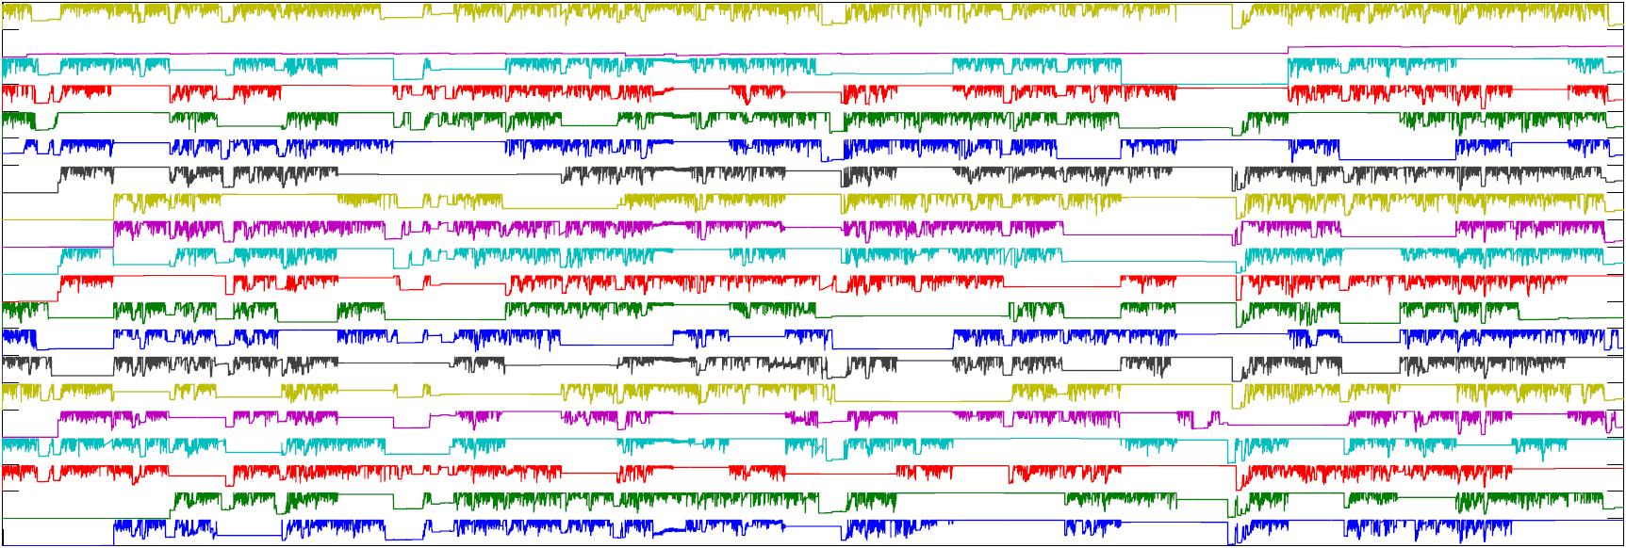
Opportunity: Optimizing for the ensemble
Dynamic provisioning across ensemble
enables cost & power savings
Intra-server variation (TPC-H, log scale)
Inter-server variation (rendering farm)
Time
Notes:
3

Slide 4
Contributions
Goal: Expand capacity & provision for typical usage
New architectural building block: memory blade
  Breaks traditional compute-memory co-location
Two architectures for transparent mem. expansion
Capacity expansion:
  8x performance over provisioning for median usage
  Higher consolidation
Capacity sharing:
  Lower power and costs
  Better performance / dollar
Notes:
4

Slide 5
Outline
Introduction
Disaggregated memory architecture
  Concept
  Challenges
  Architecture
Methodology and results
Conclusion

Slide 6
Disaggregated memory concept
Blade systems with disaggregated memory
Conventional blade systems
DIMM
DIMM
DIMM
CPUs
Backplane
CPUs
DIMM
DIMM
DIMM
DIMM
DIMM
DIMM
DIMM
DIMM
CPUs
DIMM
CPUs
DIMM
DIMM
DIMM
DIMM
Leverage fast, shared communication fabrics
Break CPU-memory co-location
Memory blade

Slide 7
What are the challenges?
Software Stack
Compute Blade
Backplane
Transparent expansion to app., OS
  Solution 1: Leverage coherency
  Solution 2: Leverage hypervisor
Commodity-based hardware
Match right-sized, conventional systems
  Performance
  Cost
App
Memory
blade
DIMM
CPUs
OS
DIMM
Hypervisor

Slide 8
General memory blade design
Perf.: Accessed as memory, not swap space
Commodity: Connected via PCIe or HT
Memory blade (enlarged)
Backplane
Protocol engine
DIMM
CPUs
DIMM
DIMM
DIMM
DIMM
DIMM
DIMM
DIMM
CPUs
DIMM
DIMM
CPUs
Memory controller
DIMM
DIMM
DIMM
DIMM
DIMM
DIMM
DIMM
DIMM
CPUs
DIMM
DIMM
Address mapping
DIMM
DIMM
DIMM
DIMM
DIMM
DIMM
Cost: Handles dynamic memory partitioning
Transparency: Enforces allocation, isolation, and mapping
Cost: Leverage sweet-spot of RAM pricing
Other optimizations
Design driven by key challenges
Notes:
8

Slide 9
Fine-grained remote access (FGRA)
Extends coherency domain
On access: Data transferred at cache-block granularity
Software Stack
Compute Blade
App
Backplane
Memory
blade
CPUs
DIMM
OS
DIMM
CF
Filters unnecessary traffic
HyperTransport
Memory blade doesn’t need all coherence traffic!
Connected via coherent fabric to memory blade (e.g., HyperTransport™)
Add minor hardware: Coherence Filter
Notes:
9

Slide 10
Page-swapping remote memory (PS)
Use indirection from hypervisor
Software Stack
Compute Blade
App
Backplane
Memory
blade
CPUs
DIMM
OS
DIMM
Hypervisor
Bridge
PCI Express
Leverage existing remapping between OS and hypervisor
On access: Local data page swapped with remote data page
Connected via commodity fabric to memory blade (PCI Express)
On access: Data transferred at page (4KB) granularity
Performance dominated by transfer latency; insensitive to small changes

Slide 11
Summary: Addressing the challenges
 | FGRA | PS
Transparent expansion | Extends coherency | Hypervisor indirection
Commodity HW | HyperTransport | PCI Express
High performance | Direct access | Leverage locality
Cost comparable | Shared memory blade infrastructure Right-provisioned memory

Slide 12
Outline
Introduction
Disaggregated memory architecture
  Methodology and results
  Performance
  Performance-per-cost
Conclusion

Slide 13
Methodology
Trace-based
  Memory traces from detailed simulation
    Web 2.0, compute-intensive, server
  Utilization traces from live data centers
    Animation, VM Consolidation, Web 2.0
Two baseline memory sizes
  M-max
    Sized to largest workload
  M-median
    Sized to median of workloads
Simulator parameters
Remote DRAM | 120 ns, 6.4 GB/s
PCIe | 120 ns, 1 GB/s
HyperTransport | 60 ns, 4 GB/s

Slide 14
Performance
Footprint > M-median
Performance 8X higher, close to ideal
8X
2X
FGRA slower on these memory intensive workloads
Locality is most important to performance
Baseline: M-median local + disk

Slide 15
Performance / Cost
Footprint > M-median
1.4X
1.3X
PS able to provide consistently high performance / $
M-median has significant drop-off on large workloads
Baseline: M-max local + disk

Slide 16
Conclusions
Motivation: Impending memory capacity wall
Opportunity: Optimizing for the ensemble
Solution: Memory disaggregation
  Transparent, commodity HW, high perf., low cost
  Dedicated memory blade for expansion, sharing
  PS and FGRA provide transparent support
Please see paper for more details!

Slide 17
Thank you!
Any questions?
ktlim@umich.edu

